Slide 1
Personal Software Process
for Engineers: Part I
Using PSP Data
SM

Slide 2
Lecture Topics
Using personal data
Making task plans
Making schedules
Tracking project status
Earned value
Estimating job completion
Project reporting

Slide 3
Using Data in Planning
When planning development work, we must
  make task plans
  make project schedules
  measure job status against the plan
  report job status to management
We must also manage the project
  manage to the schedule
  manage plan changes
  manage project risks
  manage product quality
This lecture covers the topics of planning and schedule management.

Slide 4
Using Personal Data -1
Precise and detailed data can help you to manage your personal and team work.
Managers and customers care about
  when you will finish the job
  what the work will cost
  the quality of the finished products
With PSP data, you will know where you stand and can provide regular updates to your managers and customers.

Slide 5
Using Personal Data -2
When all team members use PSP data to plan, manage, and track their personal work, the team can precisely report job status.
  This will provide management with the information that they need.
  It will also reassure the customers.
Most importantly, using data will
  convince management that you can manage your own work
  allow management to continue supporting self-directed teamwork

Slide 6
Making Task Plans -1
For both individual and team plans, the first steps are to
  understand the job’s goals and objectives
  establish a strategy for doing the work
  define the processes to use
Then, you can
  estimate the size of the job
  define the tasks to be done
  estimate the effort for each task
  establish the task order
  produce the schedule

Slide 7
Making Task Plans -2
With the PSP, you
  were given the goals, strategy, and process
  used the task order defined by the process
  used PSP data to estimate the work
  followed the process to do the job
On a team project, the team must
  agree on team goals
  establish a strategy for the work
  define the process to use
  make a team plan
These teambuilding steps will be described in week 2.

Slide 8
Making Task Plans -3
After the team has made the overall plan, the next step is to break it into individual tasks.
These tasks are assigned to the various team members to plan and to implement.
When you are assigned team tasks, you use the PSP to
  estimate and plan each task
  follow your personal process to do the work
  measure, track, and manage each step of the job
The PSP works for individuals, whether they work alone or on team projects.

Slide 9
Scheduling
Once you have determined the task order and task time, you can make the project schedule.
This involves both project and period planning.
The project plan consists of the tasks, task times, and task order.
Period planning involves spreading the project tasks over a calendar period.

Slide 10
The Importance of Period Plans
Developers focus on project plans, but live in a periodic world.
  Projects have committed dates.
  Businesses collect revenue, declare dividends, and pay salaries.
  We all pay monthly bills and collect periodic paychecks.
  We also take time off for weekends and scheduled vacations.
The relationship between project plans and period plans is the source of most project problems.
That is why it is important to use sound methods when making the project schedule.

Slide 11
Schedule Estimating
To make a schedule, you need three things.
  the estimated direct project hours for each task
  a calendar of available direct hours
  the order in which the tasks will be done
Then, you need to
  estimate the hours needed for each task
  spread these task hours over the calendar of available hours

Slide 12
Available Direct Hours
Staffing schedule
  New projects are not instantly staffed.
  You need a committed staffing plan.
Produce a calendar spread of available hours.
  At 52 weeks per year and 40 hours per week, 1 year = 2080 hours.
  With 3 weeks of vacation and 10 holidays, 1 year =1880 hours (90%).
  With 10% for meetings and 15% for mail and interrupts, 1 year ≈ 1000 to 1400 hours (50 to 65%).
  Additional time is usually spent on project activities that are not related to the direct tasks.

Slide 13
Task Order
The task order is driven by the development strategy.
  You need a conceptual approach.
  Each task needs completion criteria.
  You must consider task interdependencies.
  Also consider cost and cycle-time priorities.
Determine the planned task order.
  The initial task order provides a basis for planning.
  The task order will change with new knowledge.

Slide 14
Produce the Schedule
Estimate the hours that each task will take.
  What portion of total hours have such tasks taken historically?
  Will anything unusual affect this project?
  To ensure that tasks are not omitted, consider the tasks for the entire project.
Spread the task hours over the calendar.
  Identify key project checkpoints.
  Use a standard format.

Slide 15
The Task Planning Template
The PSP task planning template is shown in table 7.2 (page 118).
To fill out this template
  list the tasks in expected completion order
  enter the estimated hours for each task
  add the hours in the cumulative hours column
At this point, start to prepare the schedule planning template.

Slide 16
Schedule Planning Template
The PSP schedule template is shown in table 7.1 (page 116).
To start filling out this template
  list the calendar dates in the left-hand column
  use days or weeks, depending on project scale
    for days, list every date
    for weeks, use a standard day (for example, Monday)
  list the planned direct project hours available each week
  add the hours in the cumulative hours column
Complete the task and schedule templates concurrently.

Slide 17
Completing the Plan
For each task
  look on the task template for the cumulative hours needed to complete that task
  on the schedule template, find the week during which those hours are first exceeded
  on the task template, enter that week’s date in the Date column for that task
You now have the task schedule.

Slide 18
Schedule Planning Example -1
On the task planning template, enter the estimated hours per task.
Task | Hours | Cum. Hours
A | 2 | 2
B | 5 | 7
C | 4 | 11
D | 7 | 18
E | 3 | 21
F | 5 | 26
G | 6 | 32
H | 3 | 35
I | 2 | 37

Slide 19
Schedule Planning Example -2
On the schedule planning template, enter the direct hours available per day or week.
Day | Hours | Cum. Hours
1 | 3 | 3
2 | 5 | 8
3 | 5 | 13
4 | 5 | 18
5 | 4 | 22
6 | 6 | 28
7 | 5 | 33
8 | 5 | 38

Slide 20
Schedule Planning Example -3
On the task schedule, enter the day (or week) during which the cumulative hours for each task is reached.
Task | Hours | Cum. Hours | Day
A | 2 | 2 | 1
B | 5 | 7 | 2
C | 4 | 11 | 3
D | 7 | 18 | 4
E | 3 | 21 | 5
F | 5 | 26 | 6
G | 6 | 32 | 7
H | 3 | 35 | 8
I | 2 | 37 | 8

Slide 21
Project Tracking -1
Project tracking would be simple if
  we always completed tasks in the planned order
  no tasks were added or deleted
This never happens.
  Requirements always change.
  Tasks get cancelled or deferred.
  Some tasks are dropped and others are added.
  Estimating errors are common.

Slide 22
Project Tracking -2
To track project status in a dynamic environment, you need a way to assign a value that measures the contribution of each task towards the whole project.
Then you can
  add up the value of the completed tasks
  compare this value to the value of the total job
  calculate the percentage of job completion
The PSP does this with a method called earned value (EV).

Slide 23
Earned Value
Earned value (EV)
  establishes a value for each task
  permits progress tracking against the plan
  facilitates tracking, even with changes to the plan
Earned value principles
  Earned value provides a common value for each task.
  This value is the percentage of the total project hours that this task is planned to take.
  The planned value is credited, no matter how long it actually took to do the task.
  No value is given for partially-completed tasks.
  Major plan changes require new plans.

Slide 24
Establish the Planned Value
On the task template
  add the number of project hours
  calculate the percentage of the total hours for each task
  enter this percentage as the planned value (PV) for that task
  calculate the cumulative PV for each task
On the schedule template, enter the cumulative planned value for the tasks to be completed each day or week.

Slide 25
Earned Value Example -1
Produce the PV, or the planned percentage of the total job that each task represents.
Task | Hours | Cum. Hrs. | Day | PV | Cum. PV
A | 2 | 2 | 1 | 5.4 | 5.4
B | 5 | 7 | 2 | 13.5 | 18.9
C | 4 | 11 | 3 | 10.8 | 29.7
D | 7 | 18 | 4 | 18.9 | 48.6
E | 3 | 21 | 5 | 8.1 | 56.7
F | 5 | 26 | 6 | 13.5 | 70.2
G | 6 | 32 | 7 | 16.3 | 86.5
H | 3 | 35 | 8 | 8.1 | 94.6
I | 2 | 37 | 8 | 5.4 | 100.0

Slide 26
Earned Value Example -2
Enter the cumulative planned value for each day (or week).
Day | Hours | Cum. Hours | Cum. PV
1 | 3 | 3 | 5.4
2 | 5 | 8 | 18.9
3 | 5 | 13 | 29.7
4 | 5 | 18 | 48.6
5 | 4 | 22 | 56.7
6 | 6 | 28 | 70.2
7 | 5 | 33 | 86.5
8 | 5 | 38 | 100.0

Slide 27
Tracking the Plan
As each task is completed, it earns the planned value.
  Enter the earned value (EV) for that task.
  Enter the date on which the task was completed.
  Add the EV-to-date in the “Cumulative EV” column.
In the schedule template, enter the cumulative EV for each day or week as it is completed.
Track earned value versus planned value by day or week.

Slide 28
Tracking the Plan Example -1
During the project, enter on the task planning template the day each task is completed.
Task | Hours | Cum. Hrs. | Day | PV | Cum. PV | Done
A | 2 | 2 | 1 | 5.4 | 5.4 | 1
B | 5 | 7 | 2 | 13.5 | 18.9 | 2
C | 4 | 11 | 3 | 10.8 | 29.7 | 4
D | 7 | 18 | 4 | 18.9 | 48.6 | 5
E | 3 | 21 | 5 | 8.1 | 56.7
F | 5 | 26 | 6 | 13.5 | 70.2
G | 6 | 32 | 7 | 16.3 | 86.5
H | 3 | 35 | 8 | 8.1 | 94.6
I | 2 | 37 | 8 | 5.4 | 100.0

Slide 29
Tracking the Plan Example -2
On the schedule template, enter the earned value (EV) for each day.
Day | Hours | Cum. Hours | Cum. PV | EV
1 | 3 | 3 | 5.4 | 5.4
2 | 5 | 8 | 18.9 | 18.9
3 | 5 | 13 | 29.7 | 18.9
4 | 5 | 18 | 48.6 | 29.7
5 | 4 | 22 | 56.7 | 48.6
6 | 6 | 28 | 70.2
7 | 5 | 33 | 86.5
8 | 5 | 38 | 100.0

Slide 30
Estimating Job Completion
Assume that the project will continue to earn EV at the same rate as in the past.
Extrapolate the time to project completion by extending the EV line until it reaches 100%.
This is the likely project completion date, unless
  the rate of progress changes
  work for the remaining tasks deviates from the original plan

Slide 31
Estimating Completion Example -1
What is the actual EV per day?
Day | Hours | Cum. Hours | Cum. PV | EV | Proj. EV
1 | 3 | 3 | 5.4 | 5.4 | 5.4
2 | 5 | 8 | 18.9 | 18.9 | 18.9
3 | 5 | 13 | 29.7 | 18.9 | 18.9
4 | 5 | 18 | 48.6 | 29.7 | 29.7
5 | 4 | 22 | 56.7 | 48.6 | 48.6
6 | 6 | 28 | 70.2
7 | 5 | 33 | 86.5
8 | 5 | 38 | 100.0
9
10
11
12
When should you expect to finish?

Slide 32
Estimating Completion Example -2
Using the actual EV earned per day (9.72), enter the projected EV by day to project completion.
Day | Hours | Cum. Hours | Cum. PV | EV | Proj. EV
1 | 3 | 3 | 5.4 | 5.4 | 5.4
2 | 5 | 8 | 18.9 | 18.9 | 18.9
3 | 5 | 13 | 29.7 | 18.9 | 18.9
4 | 5 | 18 | 48.6 | 29.7 | 29.7
5 | 4 | 22 | 56.7 | 48.6 | 48.6
6 | 6 | 28 | 70.2 |  | 58.3
7 | 5 | 33 | 86.5 |  | 68.0
8 | 5 | 38 | 100.0 |  | 77.8
9 |  |  |  |  | 87.5
10 |  |  |  |  | 97.2
11 |  |  |  |  | 100.0

Slide 33
Plan Changes -1
To track job progress, you must follow the plan.
Since plans always change, you must regularly update the plan so that it represents what you currently plan to do.
Of course, you must always keep copies of the original plans.
Unless the plan differs significantly from the way that you now plan to work, merely add any new tasks and delete the cancelled ones.

Slide 34
Plan Changes -2
Adding tasks reduces the earned value of all of the planned and completed work.
Similarly, deleting tasks increases the earned values of the planned and completed tasks remaining in the plan.
Most TSP support tools will make these EV and PV adjustments for you.
For major plan changes, you must make a new plan.

Slide 35
Project Reporting
When all team members consistently record their data, TSP teams will know precisely where they stand.
They can track, manage, and report on their work.
The following charts show how you can use these data to run a project.
You can use these exact same methods to manage your personal work.

Slide 36
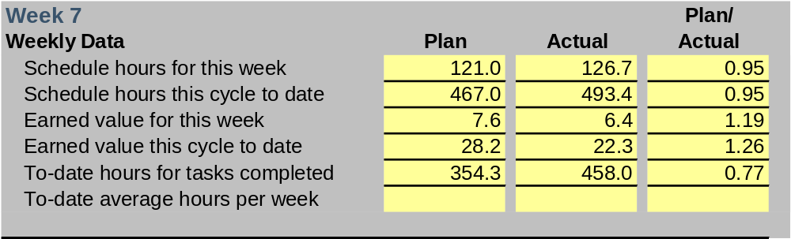
Example TSP Weekly Data -1
When all team members consistently record their data, TSP teams can precisely track and manage their work.
  They know the planned and actual data for each week and for the project to date.
  They can precisely measure job status and estimate how long it will take to finish the work.

Slide 37
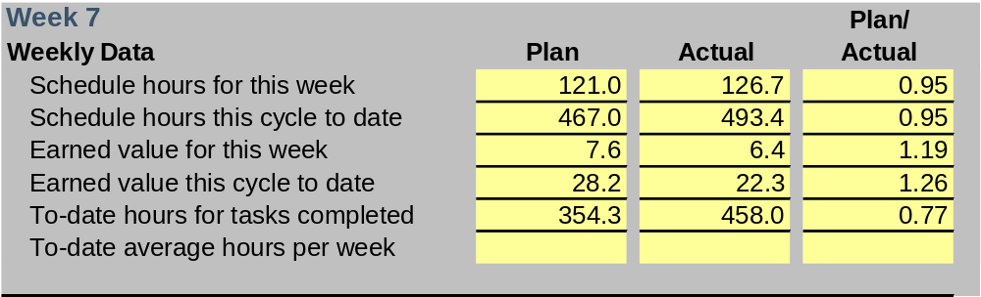
Question 1
Is this team ahead of or behind schedule, and by how much?

Slide 38
Answer to Question 1
Is this team ahead of or behind schedule, and by how much?
The team has earned only 22.3 EV against a plan of 28.2 EV, so they are 26.5% behind.
At the current rate, it will take 1.85 weeks to reach the planned 28.2 EV, so they are 1.85 weeks behind schedule.

Slide 39
Question 2
Why is the team behind schedule?

Slide 40

Answer to Question 2
Why is the team behind schedule?
Although the team is working more than its planned weekly hours, the work is taking 23% longer than planned.

Slide 41
Question 3
At this rate, can the team members finish on the original plan of 25 weeks? If not, how late will they be?

Slide 42

Answer to Question 3
At this rate, can the team members finish on the original plan of 25 weeks? If not, how late will they be?
The team has earned EV at 22.3/7 = 3.186 EV/week.
At this rate, it will take (100-22.3)/3.186 = 24.2 more weeks to finish. This is 6.2 weeks behind the 25-week plan.

Slide 43
Question 4
Can this five-person team meet the original schedule? If not, what help would they need from management to do so?

Slide 44
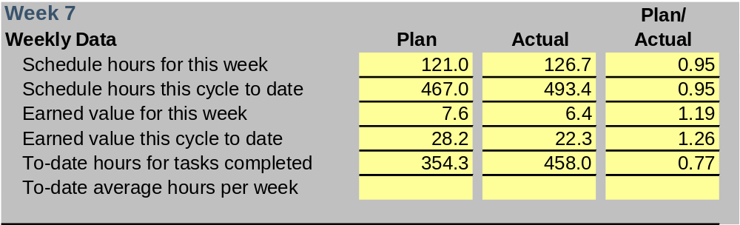
Answer to Question 4
Can this five-person team meet the original schedule? If not, what help would they need from management to do so?
To meet the schedule, they need to do 77.7 EV of work in 17 weeks, or 4.57 EV a week.
To increase their average EV rate of 3.186 EV a week by 35%, they must work 35% more hours, or add a team member.

Slide 45
Example Conclusions
This team did increase their task hours somewhat and they also spent less time than planned in test.
They also reprioritized the work and slightly reduced the total workload.
They actually finished on the exact day originally planned.
With the PSP, you will precisely know job status and will have the data to manage your own work.
With this knowledge, you will usually meet your commitments.

Slide 46
Messages to Remember
With the PSP, you can accurately plan and track your own work.
With earned value, you can precisely judge job status and estimate the likely project completion date.
This information will permit you to make accurate and timely management reports.
When your reports indicate potential problems, you should report recommended remedial actions.
On a self-directed team, you must tell management what you are doing to solve your own problems.

